Slide 1
CS4499/5599: Data Science and Applied Machine Learning
Class Lecture: February 1st, 2023

Slide 2
Objectives
Last time:
Benefits of Visualization
Matplotlib Python Package
Histograms, Bar plots, Pie charts, etc.
Today:
Pandas Functions for plotting
Seaborn
Pandas filter, apply and lambda

Slide 3
Plotting with Pandas
Pandas has a number of built-in functions that can be used for plotting
The advantage of these functions is that they are better optimized for working with pandas DataFrames
That said these functions still make use of Matplotlib to produce the plot
A major disadvantage of this approach is that it only works with pandas data structures (series and DataFrames)

Slide 4
Plotting with Pandas
Unlike Matplotlib, pandas only uses a single function to produce plots, the .plot() function
When working with .plot() you use the kind argument to specify what kind of plot you want
The user can then specify the data for the plot (x and y) if needed
The user can add labels, tick marks, etc. using the same arguments as with Matplotlib

Slide 5
Plotting with Pandas
These argument can be used to create different types of plots using .plot()
‘bar’/‘barh’ for bar plots
‘hist’ for histogram
‘box’ for boxplot
‘kde’/‘density’ for density plots
‘area’ for area plots
‘scatter’ for scatter plots
‘hexbin’ for hexagonal bin plots
‘pie’ for pie plots

Slide 6
Seaborn
Another useful package for data visualization is Seaborn
Seaborn is an extension of Matplotlib that was designed to create visualization closer to MATLAB
Seaborn is optimized to work better with Pandas DataFrames and NumPy arrays
We will go over some of the Seaborn plots as we go in the class.

Slide 7
Seaborn Features
One key feature in Seaborn is the ability to implement themes with your plots
Seaborn has five themes you can use: darkgrid (default), whitegrid, dark, white, and ticks
Seaborn has several different datasets that can be used for a variety of purposes:
https://github.com/mwaskom/seaborn-data
This package tends to be the favorite of data scientist looking to visualize result from machine learning and statistics.

Slide 8
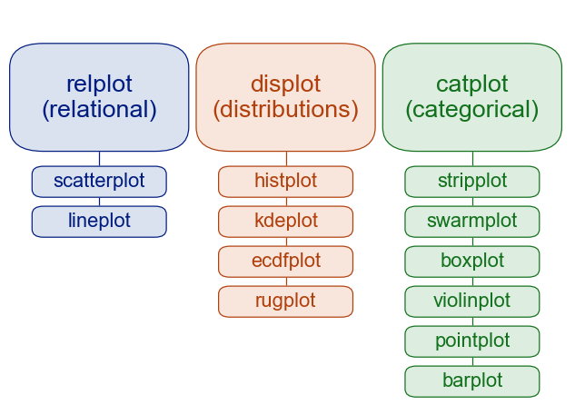
A Guide to Choosing Plots
Source: https://seaborn.pydata.org/tutorial/function_overview.html

Slide 9
Pandas Filter
Now that we have some visualization tools, we should cover a few more pandas functions that we will use
In data science getting our datasets in the proper format can be the most complicated challenge
The .filter() method can allow us to remove all the unnecessary data and create DataFrames that are better suited for our purposes

Slide 10
Pandas .apply()
Very rarely outside of academia will a data scientist control all mechanism for data collections and storage
As such it is very common that you will need to make a specific change to an entire column of data
Some common cases are that data is entered incorrectly, data is in the incorrect format, etc.
.apply() is a useful method in these cases
We can use .apply() to perform an operation (usually a function of some sort) on an entire field at once

Slide 11
Pandas Lambda
Lambda functions are helpful approach for applying functions to our dataset
Lambda functions are just temporary functions we can apply to our DataFrame
We can use the following format to apply the functions:
lambda parameter_arguments : return_expression

Slide 12
Next Time
We will wrap up our discussion on pandas by going over .loc and .iloc
If we have time we may start statistical analysis
Assign Homework 3

